Slide 1
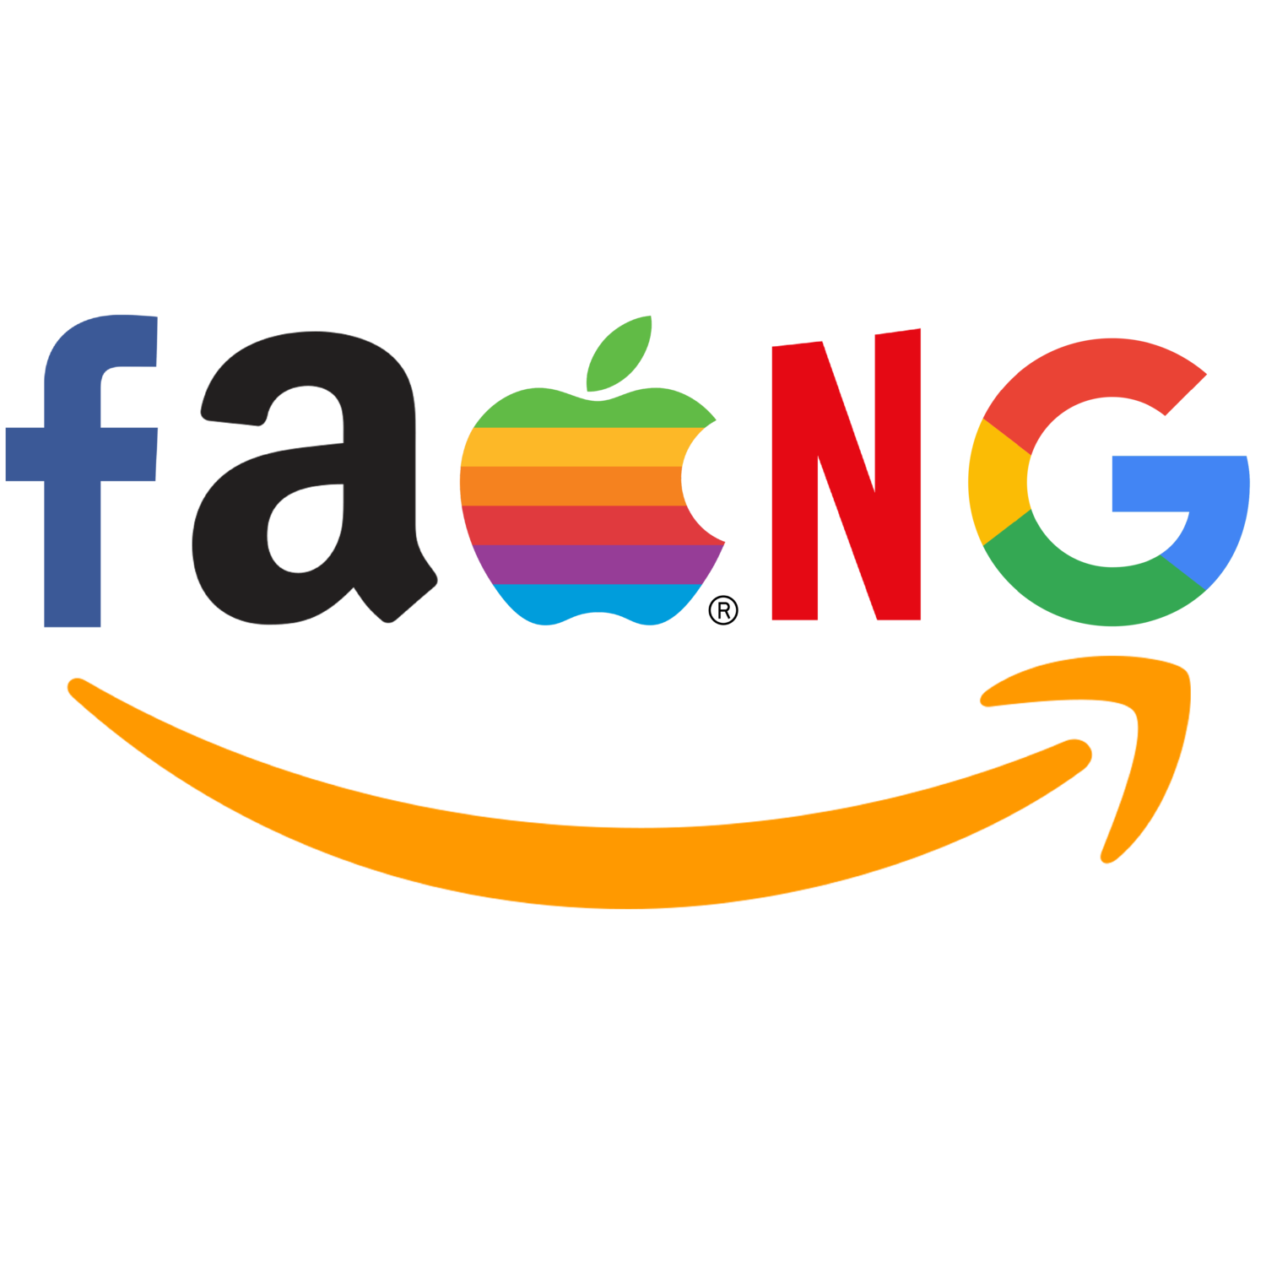
What FAANG Company Should You Work For?

Slide 2
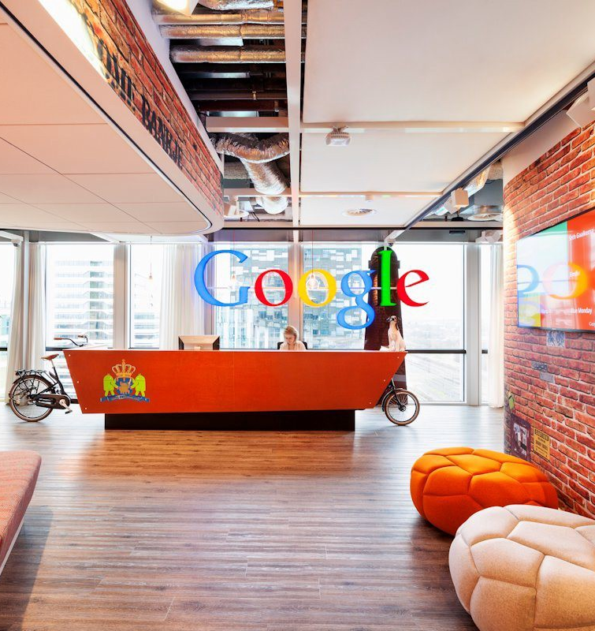
Background
Highly skilled students like us have a tough decision ahead
Data science roles at these companies are similar in terms of functionality
Choosing the right company depends on work life preferences

Slide 3

Objective
Scrape data
Insights
Recommendations
Scraped reviews from Glassdoor for each of the 5 FAANG Companies
This included pros/cons and advice to management
Find:
Top 5 key topics in company reviews
Difference in sentiment of former vs current employees
Difference in sentiment pre and post COVID
Difference in sentiment across departments
Recommend to MMA students which of these companies is the best to work for

Slide 4
Hypothesis
Based on initial research obtained from general news and social media, we have formulated the following hypotheses:
1. Google will have the best employee satisfaction pre AND post COVID
2. Amazon will have the worst employee satisfaction pre AND post COVID
3. Overall, former employees will provide more negative reviews than current employees
4. The supply chain department at Amazon will have the highest dissatisfaction

Slide 5
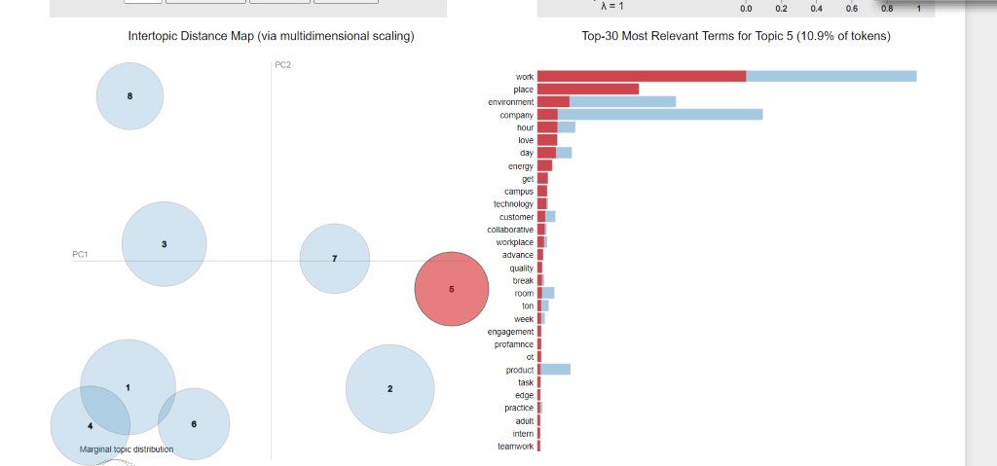
Topic Modeling
Creating Document Term Matrix
Using the list of nouns we had obtained from the pre-processing phase
Building LDA Model
Used perplexity and coherence optimization to find the optimal number of topics for both pros and cons
Visualizing topics with pyLDAvis
Visualized the topics to further examine how many to use, and which ones (demo coming up next)
Issues
Noise sensitivity and instability caused our topics to be poorly defined and difficult to interpret
Solution
Bi-grams!
Notes:
Coherence score needs to be bigger, and perplexity needs to be smaller

Slide 6
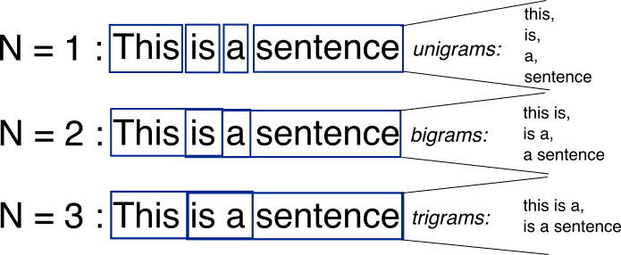
Bi-Grams
N-Grams
Sequence of n words, so a bi-gram is a two-word sequence of words like ”work life”
Used this as another layer of confirmation of the topics
Bi-Grams -> Topics
Identified top 5 topics discussed in pros and cons across all companies and departments
Replaced all bi-grams that coincide with these topics with the topic
Obtained normalized frequency of the topics per department
Insights
By looking at the pros and cons sections of the reviews, we gained an understanding of what company attributes employees from different departments at FAANG companies tend to praise and what they tend to criticize (visualization on next slide)

Slide 7
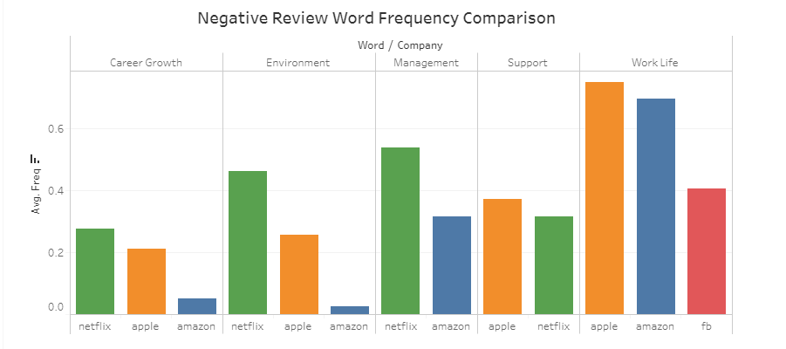
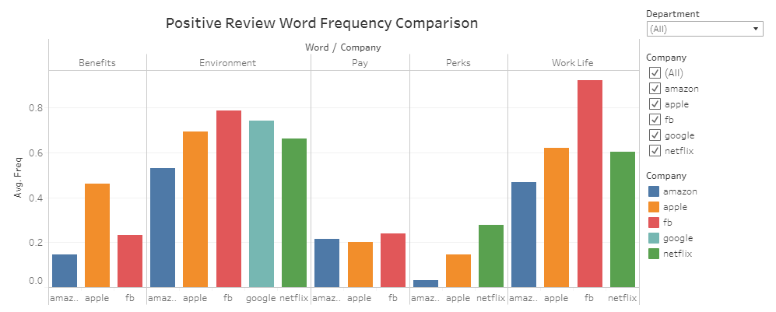
Bi-Gram Results
Key Insights:
When talking about Work Life negatively, Apple and Amazon employees mention it the most of any FAANG company
Facebook employees mention their environment in a positive light the most
Netflix employees think negatively about their career growth the most often
Overall, Google employees rarely give negative reviews compared to the other companies

Slide 8
Sentiment Analysis – Key Insights
Current vs Former Employees
Former employees at amazon and facebook were very negative in the cons sections of their reviews
Largest discrepancy between current and former employees occurs at Facebook
Across Departments
The finance department at Amazon had highly negative remarks in the cons section of the reviews
The sentiment of the cons section from Facebook’s finance department were very positive
Same for legal department at Netflix
Pre vs Post COVID
Facebook’s sentiment increased after COVID significantly
Meanwhile, every other company had a slight decrease in sentiment

Slide 9
TABLEAU DASHBOARD

Slide 10
Conclusion/Recommendations
Based on the topic modeling, bi-grams, and sentiment analysis we have concluded that:
There is no significant evidence that COVID had an impact on the employee experience at these companies
Facebook should interview former employees as to why they left, as they left the most negative reviews
Apple should address the concerns of people in their marketing department based on the cons sections of the reviews
If you want the best….
Benefits – Apply to Apple
Environment – Apply to Facebook
Pay – Apply to Amazon/Facebook
Work Life – Apply to Facebook
Perks – Apply to Netflix

